Slide 1
Chapter 5
The Economic Determinants of Democracy and Dictatorship

Slide 2
From last time:
A state is an entity that uses coercion and the threat of force to rule a given territory
A government is a set of people who run the state; they are the means through which state power is exercised
A regime is a set of rules, norms, or institutions that determine how the government is constituted, organized and major decisions are made
Examples: (post-colonial) United States, the French Fifth Republic

Slide 3
Regimes
From here on out we will mostly be interested in regimes.
Is a regime a democracy or a dictatorship?
What are the factors that cause different regime types to emerge?
What type of democratic regime is it?
What type of dictatorial regime is it?
What are the effects of different types of regimes?

Slide 4
Modernization Theory and Democracy
(Economic) modernization theory argues that all countries pass through the same historical stages of economic development.
Contemporary underdeveloped countries are merely at an earlier stage in this linear historical progress.

Slide 5
Modernization Theory and Democracy
(Economic) modernization theory argues that all countries pass through the same historical stages of economic development.
Contemporary underdeveloped countries are merely at an earlier stage in this linear historical progress.
(Political) modernization theory argues that
Economic development determines political regimes, and
since all countries pass through the same historical stages of economic development, then
All countries pass through the same historical stages of political development

Slide 6
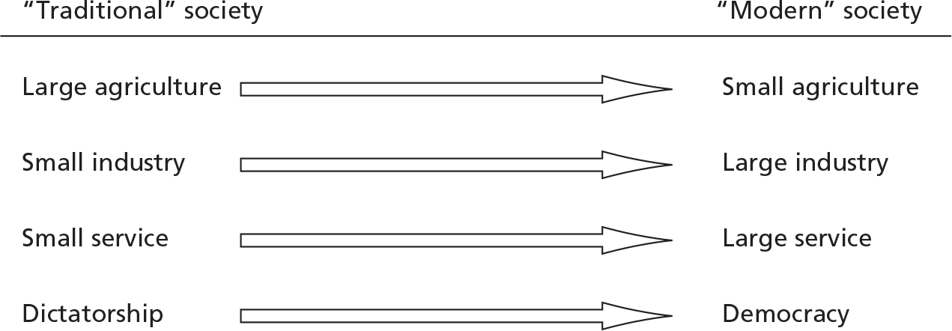
Modernization Theory and Democracy

Slide 7
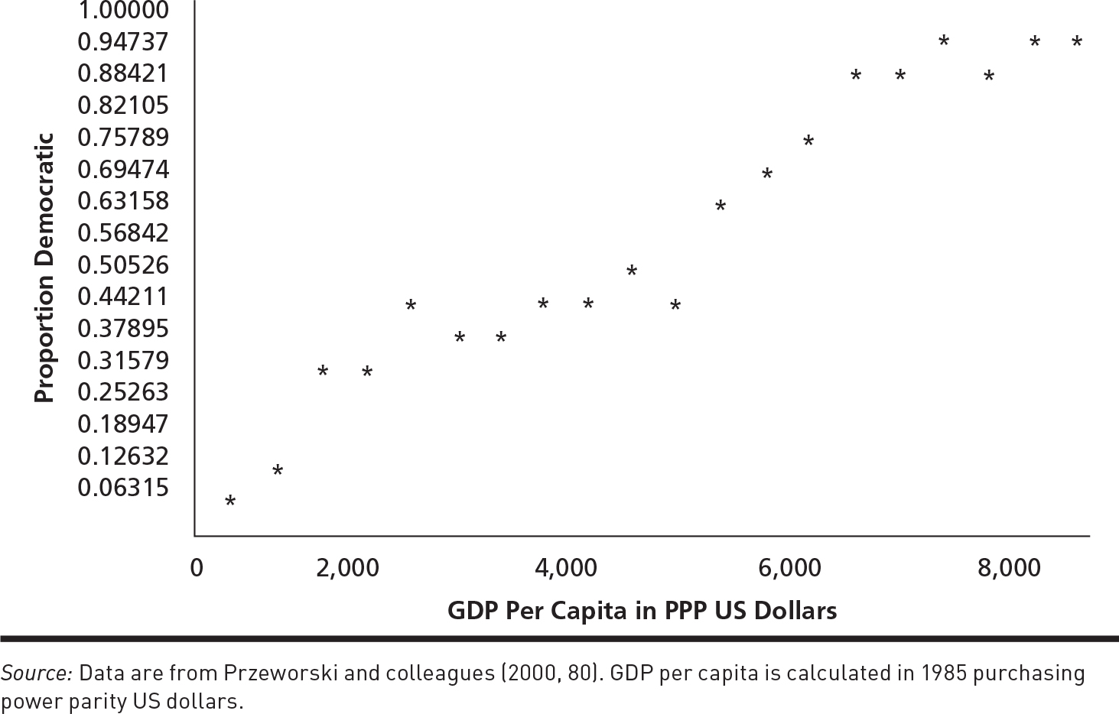
Modernization Theory and Democracy
One of the central implications of modernization theory is that there should be a strong positive relationship between economic development and democracy.

Slide 8
Modernization Theory and Democracy
One of the central implications of modernization theory is that there should be a strong positive relationship between economic development and democracy.
Wealth increases:

Slide 9
Modernization Theory and Democracy
One of the central implications of modernization theory is that there should be a strong positive relationship between economic development and democracy.
Democracy increases:
Wealth increases:

Slide 10
Modernization Theory and Democracy
Income and democracy seem to increase together
In other words:
There seems to be a strong positive relationship between income and democracy.
Does this necessarily mean that modernization theory is correct?
It turns out that the data are consistent with two different stories linking income and democracy.

Slide 11
Modernization Theory and Democracy
Modernization Theory
Modernization theory predicts that countries are more likely to become and remain democratic as they become richer.
Survival Story–Przeworski
The survival story predicts that democracy is more likely to survive as countries develop and become richer, but it is not more likely to emerge.

Slide 12
Modernization Theory and Democracy
Why Does Income Help Democratic Survival?
Choice between democracy and dictatorship can be thought of as a choice between:
A system in which you are guaranteed a minimal standard of consumption (democracy)
A system in which you win or lose everything (dictatorship)
When you are rich, getting a bigger share of the pie affects your welfare only a little. In contrast, losing everything would be disastrous.

Slide 13
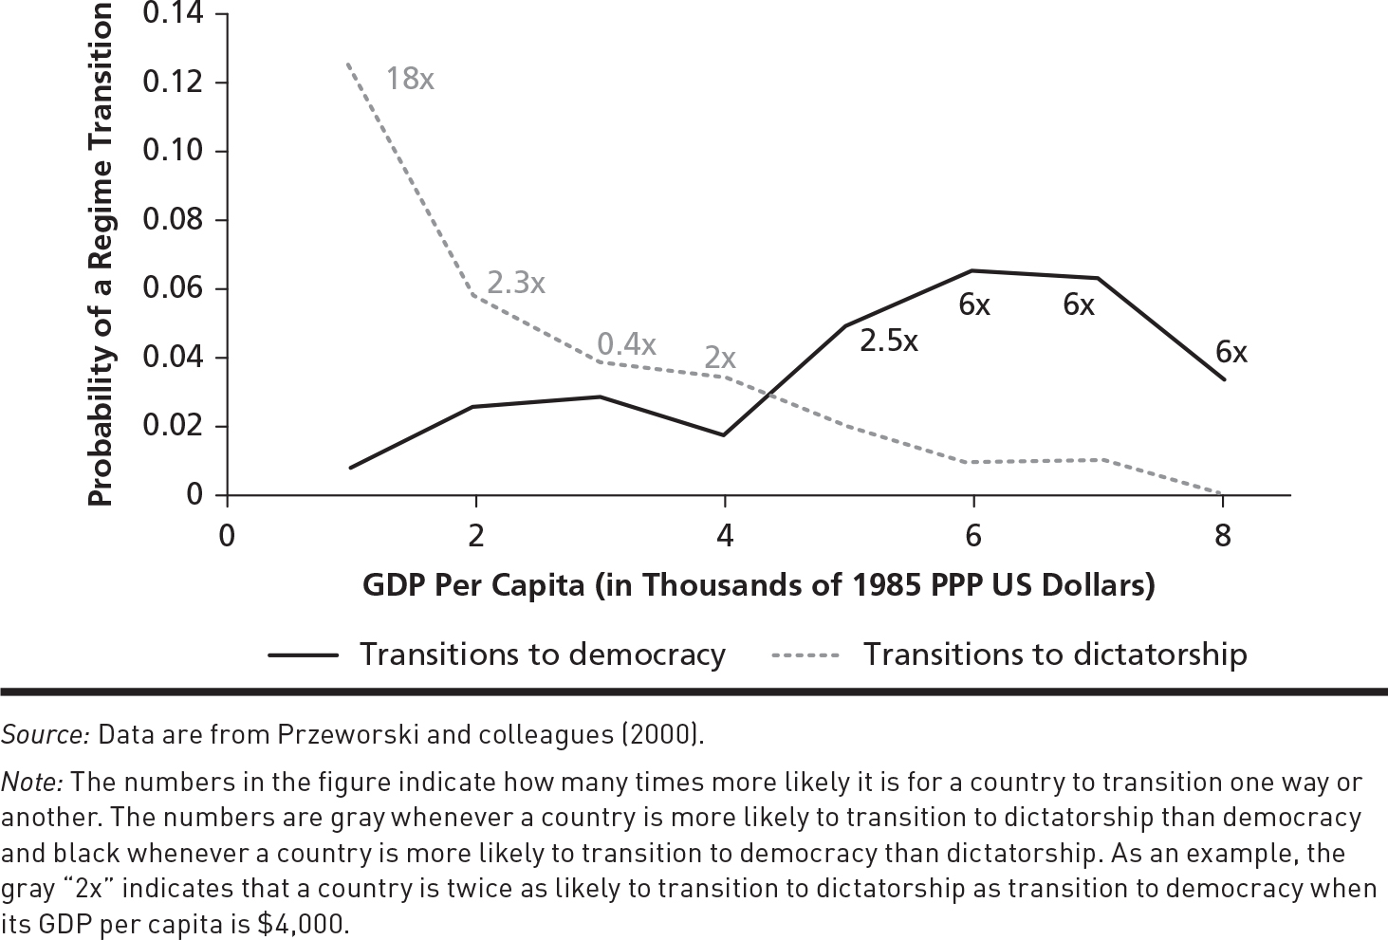
Modernization Theory and Democracy
We need to look at how income affects the probability of democratic emergence and the probability of democratic survival.

Slide 14
Modernization Theory and Democracy
We need to look at how income affects the probability of democratic emergence and the probability of democratic survival.
What does the data show?
Additional income is positively associated with both the emergence and survival of democracy.

Slide 15
A Variant of Modernization Theory: Mobile Asset Theory
According to mobile asset theory It is not income per se that encourages democratization.
It is the changes in the socioeconomic structure that accompany increases in income in the modernization process.
The same idea helps to explain why countries that are dependent on revenue from natural resources tend to be dictatorships rather than democracies.

Slide 16
A Variant of Modernization Theory
Economic Development and Democracy
According to modernization theory, all societies move through a series of stages.
As they move through these stages, the structure of the economy changes.
The relative size of the “sectors” in the economy change.
Specifically, we see a shift from a focus on agriculture to a focus on manufacturing and services.

Slide 17
A Variant of Modernization Theory
Economic Development and Democracy
Many scholars have argued that these structural changes occurred in early modern Europe.
Peasants moved from rural to urban areas and the gentry became increasingly involved in commercial activities in the towns.
Bates and Lien (1985) have argued that these changes played a crucial role in the creation of representative government in England. Why and how?
“No bourgeoisie, no democracy.” – Barrington Moore

Slide 18
Structure of the Economy
At the onset of the industrial revolution, changes in the economy produced a shift in economic power away from traditional agricultural elites who controlled easily observable assets to a rising class of wool producers, merchants, and financial intermediaries who controlled assets that were more difficult to observe—
mobile assets
Key idea: The state can really tax or predate only on those assets that they can locate, observe, and count.

Slide 19
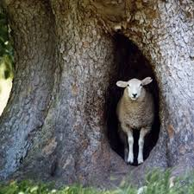
Democracy &Economic Structure: Can you hide your loot?
mobile assets?

Slide 20
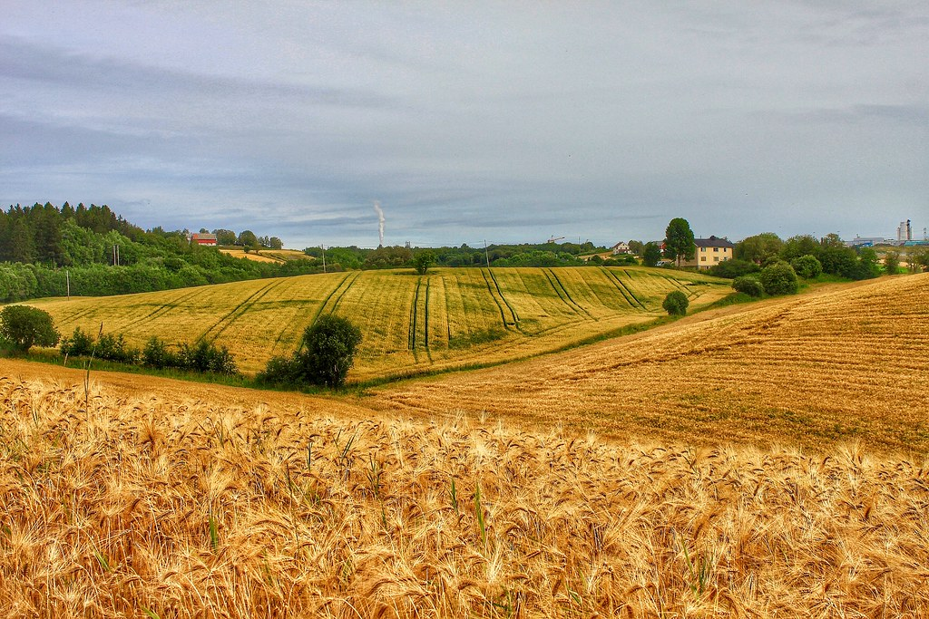



Can you hide your loot?
Im-mobile Assets
Mobile Assets
Notes:
Immobile: crop production; natural resources
Mobile: Finance, services and intellectual property

Slide 21
Structure of the Economy
Bates and Lien argue that the increased ability of the gentry to hide their assets from state predation changed the balance of power between modernizing social groups and the traditional seats of power such as the Crown.
The Crown, which needed money, now had to negotiate with the new economic elites to extract revenues.
In return for paying their taxes, the economic elites demanded limits to state predation.
This produced the supremacy of Parliament over the Crown.

Slide 22
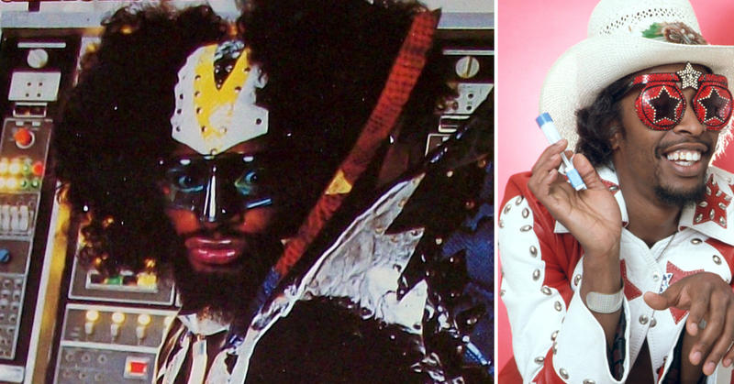
Supremacy of Parliament
George Clinton (L) and Bootsy Collins (R): Key members of the Parliament-Funkadelic musical collective.

Slide 23
Structure of the Economy
North and Weingast (1989) present a similar story.
Now that economic actors could hide their assets, the Crown had to find some way to credibly promise not to predate on economic elites.
Otherwise the elites would ”exit” and the crown, being dependent on the elites, would lose out on economic growth and tax revenue
One way to do this was to give Parliament the power to check the Crown.
This story helps to explain the Glorious Revolution of 1688, which saw the establishment of modern parliamentary democracy in Britain.

Slide 24
Structure of the Economy
Bates and Lien argue that the introduction of this more limited state occurred earlier and more definitively than it did in France because of the unique structure of the economy that early modernization had produced in England.
To see why, let’s return to the Exit, Voice, and Loyalty game from Chapter 3.

Slide 25
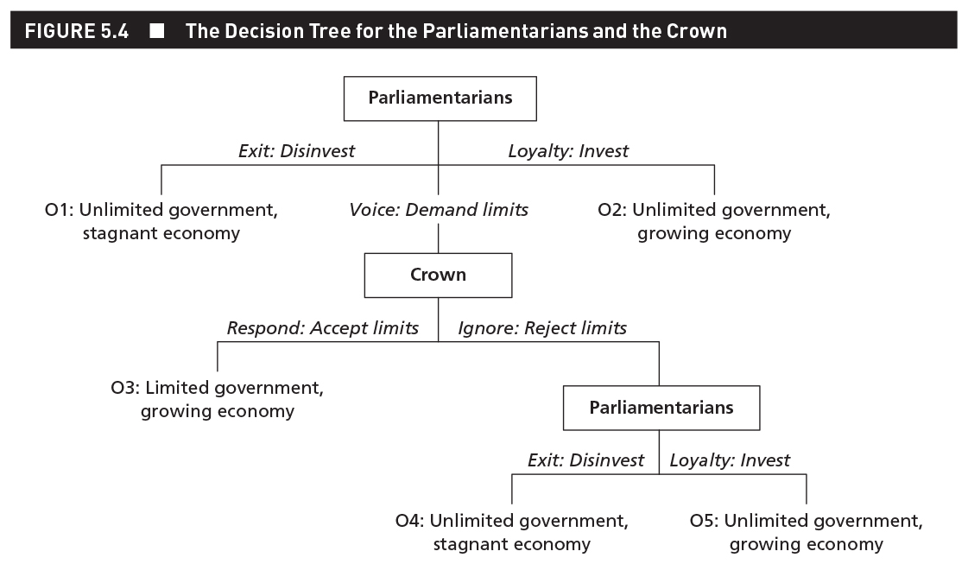

Slide 26
EVL: Parliamentarians and the Crown
Table 5.2: Summary of Possible Outcomes in the EVL
 | Crown
Parliamentarians | Is autonomous | Is dependent
Have a credible exit threat | O1: Poor dictatorship [unlimited government, stagnant economy] | O3: Rich democracy [limited government, growing economy]
Have no credible exit threat | O2: Rich dictatorship [unlimited government, growing economy] | O2: Rich dictatorship [unlimited government, growing economy]
Notes:
This is NOT a payoff matrix.
Governments that are dependent on actors with mobile assets won’t be democratic in the majoritarian sense, but since the number of citizens with mobile assets tends to increase with economic development, then government should become gradually more responsive over time.

Slide 27
A Variant of Modernization Theory
Natural Resources and Democracy
Our variant of modernization theory also provides an explanation for something called the political resource curse.
According to the political resource curse, countries that depend on revenue from natural resources, such as oil, diamonds, and minerals, will find it difficult to democratize.

Slide 28
A Variant of Modernization Theory
Natural Resources and Democracy
Why do natural resources help dictators stay in power?
There are two types of explanations for a hurdle to democracy:
Demand for democracy reduced
Supply of democracy reduced

Slide 29
A Variant of Modernization Theory
Natural Resources and Democracy
Demand side explanations include:
Governments don’t need to raise revenue by taxing their citizenry (Saudi Arabia, other Gulf states)
Governments are unlikely to respond positively to demands for greater representation even if citizens were to make them. So,
Governments are free to predate on this sector of the economy safe in the knowledge that private actors don’t have a credible exit option—you can’t take your oil wells with you, or hide them—and thus can’t exert influence over them.

Slide 30
A Variant of Modernization Theory
Natural Resources and Democracy
Supply side explanations include:
Revenue from natural resources can be used to buy off:
Opposition parties
The military
Citizens and bureaucrats

Slide 31
A Variant of Modernization Theory
Natural Resources and Democracy
Two things are worth noting about the political resource curse.
It doesn’t say that having an abundance of natural resources is necessarily bad for democratization.
It’s whether or not the state is overly dependent on natural resources for its revenue
It is about the emergence of democracy, not the survival of democracy.
Canada, Norway, UK, US all established democracies before becoming resource rich

Slide 32
A Variant of Modernization Theory
Foreign Aid and Democracy
How does foreign aid affect democratization?
Aid optimists think that foreign aid can spur democratization efforts.
Aid pessimists think that foreign aid has a negative effect on democratization reforms.

Slide 33
A Variant of Modernization Theory
Foreign Aid and Democracy
The EVL theory highlights one way in which foreign aid hinders democratization.
However, it also suggests there may be conditions under which foreign aid can encourage limited democratic reforms.

Slide 34
A Variant of Modernization Theory
Foreign Aid and Democracy
Many scholars claim that income from foreign aid is essentially the same as income from natural resources.
Both represent forms of unearned income that increase the autonomy of governments relative to their citizens.
Not good for democracy in the EVL framework

Slide 35
A Variant of Modernization Theory
Foreign Aid and Democracy
Foreign aid can promote democratization, but only under certain conditions:
The recipient country is dependent on the foreign aid.
The aid donor wants to promote democratic reform in the recipient country.
The aid donor can credibly threaten to withdraw aid if its demands for reform are not met.
Notes:
More stringent than in other EVL stories, b/c the third criteria---that the donor wants to promote democratic reform.

Slide 36
A Variant of Modernization Theory
Inequality and Democracy
It’s commonly argued that economic inequality undermines democracy.
The argument lacks strong empirical support.\
Little evidence that inequality increases demand for income redistribution.
Modernization theory and EVL explains these inconsistent results by incorporating credible exit options.
There is a difference between income inequality and land inequality.
Land inequality does seem to inhibit democracy
Notes:
Poor are dependent on the rich’s resources for economic growth, so therefore might limit their redistribution—if assets are mobile. Inequality should be bad for democracy when elites don’t have mobile assets
Landed elites have immobile assets, so land inequality is likely bad for democracy
In both cases elites don’t want to democratize

Slide 37
A Variant of Modernization Theory
Economic Performance
The argument suggests that democracies should produce reasonably good economic performance.
In contrast, some dictatorships should have pretty good economic performance and some should have pretty bad economic performance.
According to the variant of modernization theory, regime type should have little impact on growth when immobile asset holders dominate the economy.
Either way, elites will continue investing, because they have no other option

